Slide 1
Algorithm Analysis and Data Structures
Week 8

Slide 2
What are we going to do today?

Slide 3
Content
C++ and C#
Linear Tables, Lists, Stacks, Queues, Vectors, Trees, Heaps, Graphs, Algorithm Types (Brute Force, Backtracking, Divide and Conquer, Dynamic, Greedy, Randomised, Heuristic, Recursive), Sorting, Searching, Complexity (Time, Space, Classes), Optimisation.

Slide 4
Optimisation and Efficiency
When we're programming, we're writing code to perform a specific task. An algorithm is a set of instructions - the procedure we ask the computer to perform - to complete that task.
For any task, there are a huge number of possible algorithms we can write to complete it. How do we decide on which one to use?
Typically, one of the main considerations we have is that we generally prefer algorithms that require fewer actions to complete. An algorithm that requires fewer instructions to complete its task is generally going to be able to complete that task faster.

Slide 5
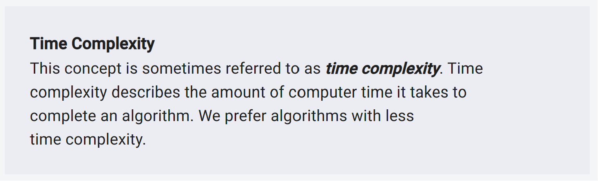
Time Complexity

Slide 6
Exercise
What scenarios can you think of where time complexity is important?

Slide 7
Algorithm Scaling
Generally, how long our algorithms take to run will depend on their inputs, specifically, the size of those inputs.
Our input's size might be the number of pixels we need to color, or the number of records we need to process. When the input is larger, our algorithms typically need to do more work.
The main thing we care about is how the input size affects the number of operations our algorithm needs to perform. As our input size increases, how many more operations does our algorithm need to perform to complete its task?
This is referred to as the scaling of our algorithm. Below, we provide examples of the most common scaling factors:

Slide 8
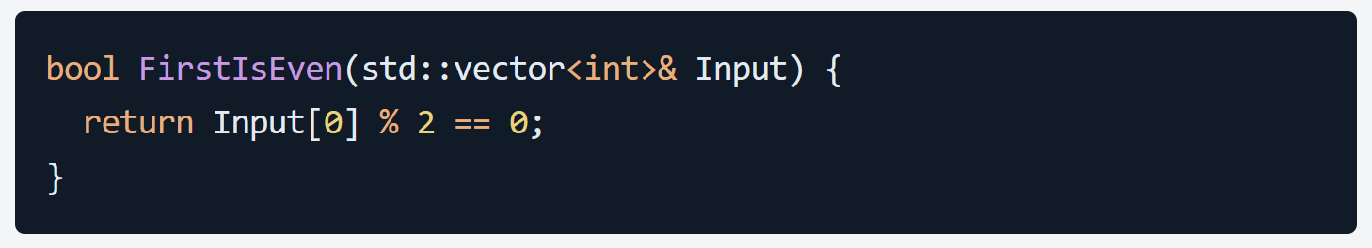
Constant Scaling
This is the best-case scenario. With constant scaling, even if our input gets bigger, our algorithm doesn't need to do any extra work. An example of a problem that can be solved in constant time is: "determine if the first element in an array of numbers is even“
Here, it doesn't matter how big the input array is - our algorithm takes the same, constant, amount of time. Here, it doesn't matter how big the input array is - our algorithm takes the same, constant, amount of time.

Slide 9
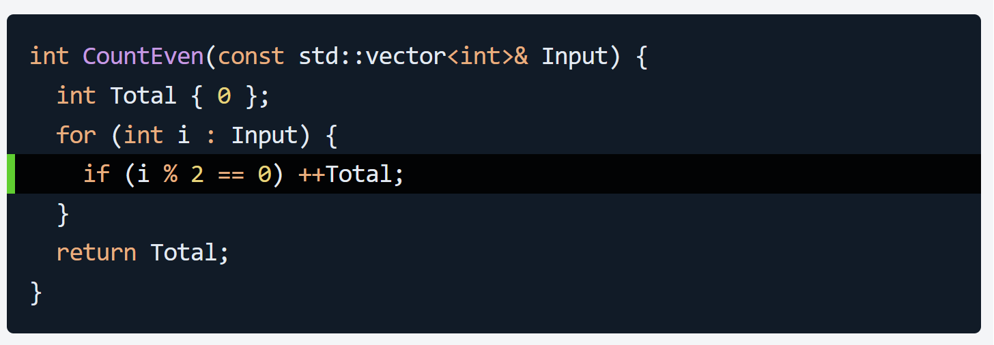
Linear Scaling
With linear scaling, as our input gets bigger, our algorithm needs to perform proportionally more work. If our input is twice as large, our algorithm needs to do approximately twice as much work.
An example of a problem that can be solved in linear time is: determine how many numbers in an array are even. To solve this, we need to inspect every element in the array.
If the array is twice as large, we need to do approximately twice as much work. We can often identify a linear algorithm by the fact it iterates over every object in our collection:
Here, if the array has 10 items, the highlighted line is executed 10 times. If the array is doubled to 20 items, the number of times the line is executed is also doubled to 20. In other words, the number of operations scales linearly with the size of the input.

Slide 10
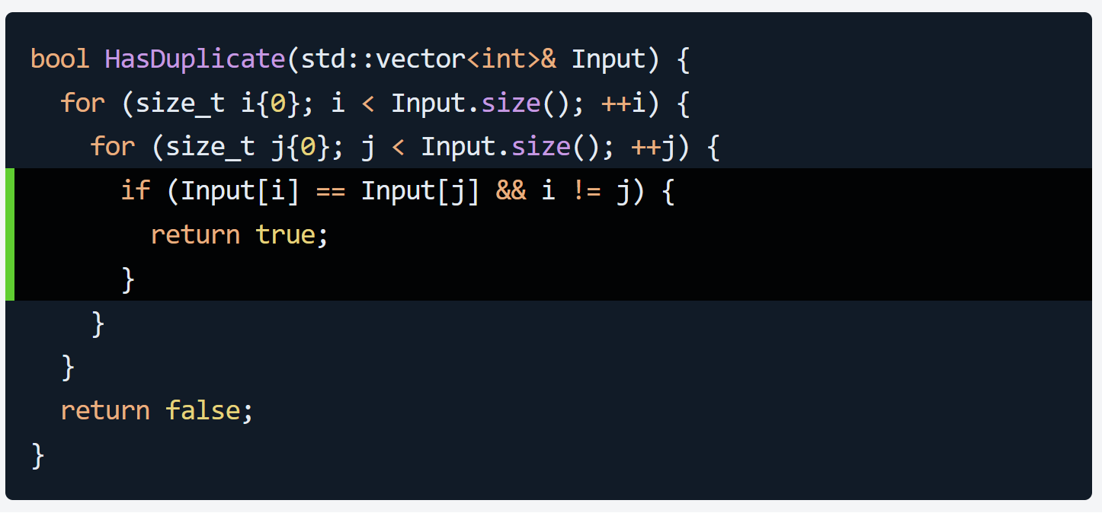
Quadratic Scaling
Algorithms in this category tend to involve nested loops. Let's imagine we have the task: "check if an array contains any duplicates"
In this example, if our input array has 10 items, the outer for loop performs 10 iterations, and each iteration causes the inner for loop to perform 10 iterations.
The net effect is that the highlighted if statement is evaluated up to 100 times - 10 x 10.
If the array is increased to 100 items, the if block is now executed up to 10,000 times. With quadratic scaling, the number of operations increases much faster than the size of the input.
In general, if our input contains n objects, this algorithm requires n x n or n squared operations to complete its task. This is an example of quadratic scaling.

Slide 11
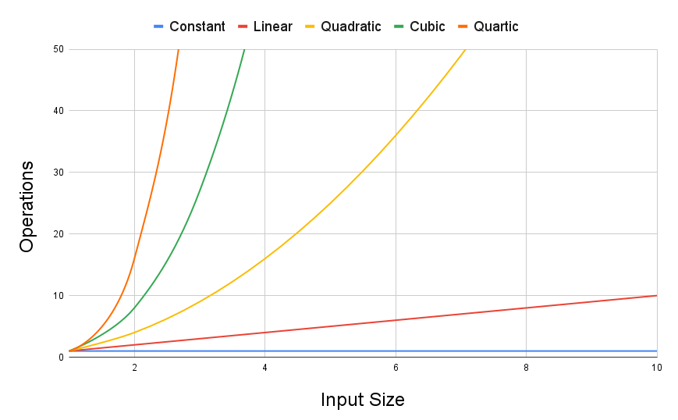
Algorithm Scaling and Big O notation
We can imagine the algorithms we create as being within certain classes of scaling:
Constant algorithms are noted as O(1)
Linear algorithms are noted as O(n)
Quadratic algorithms are noted as O(n2), and so on.

